Slide 1

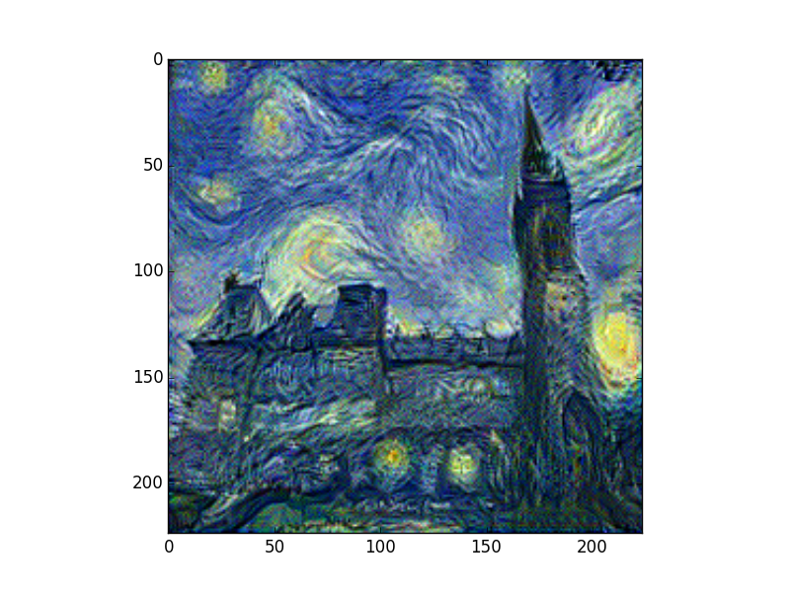
Deep Neural Network
Learns Artistic Style
An artificial System based on Neural Network to create artistic images

Slide 2
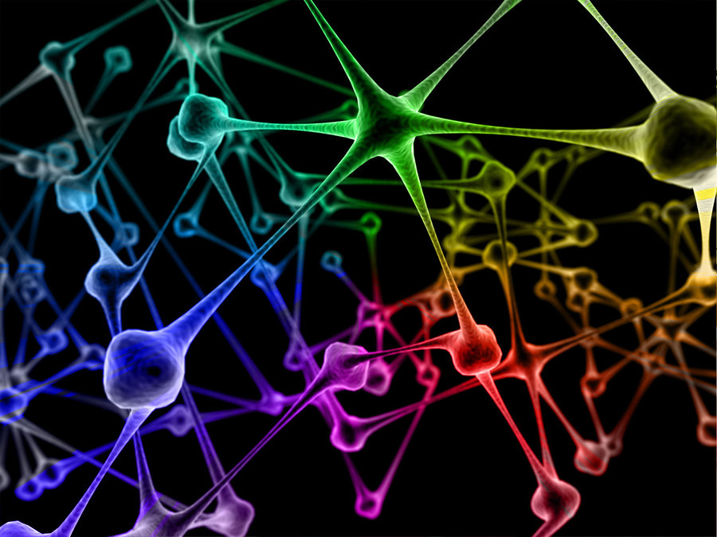
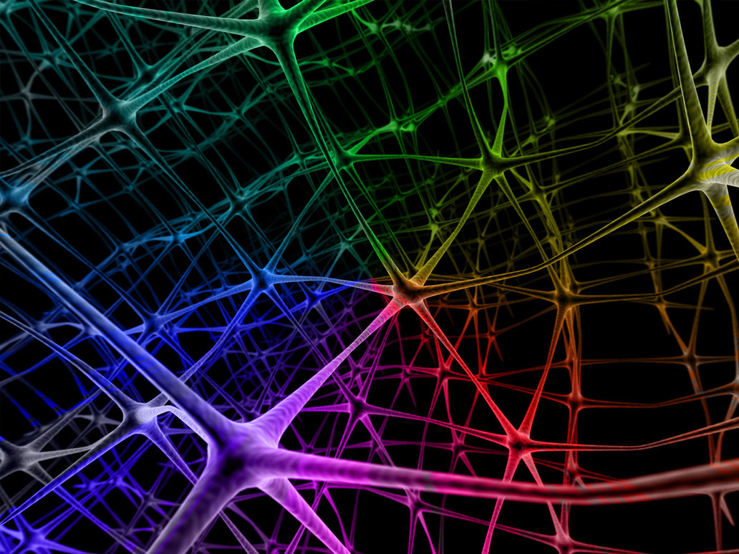
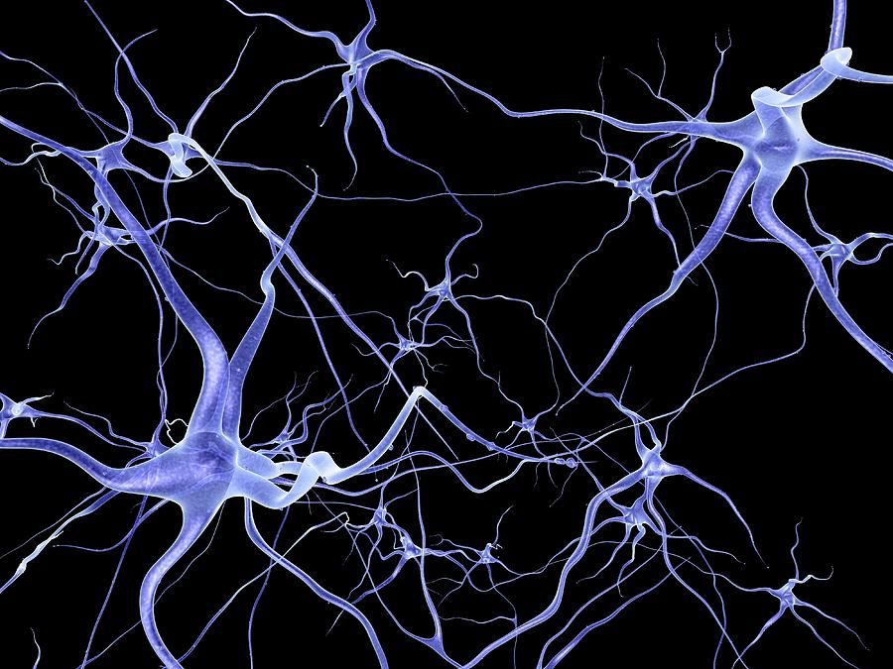
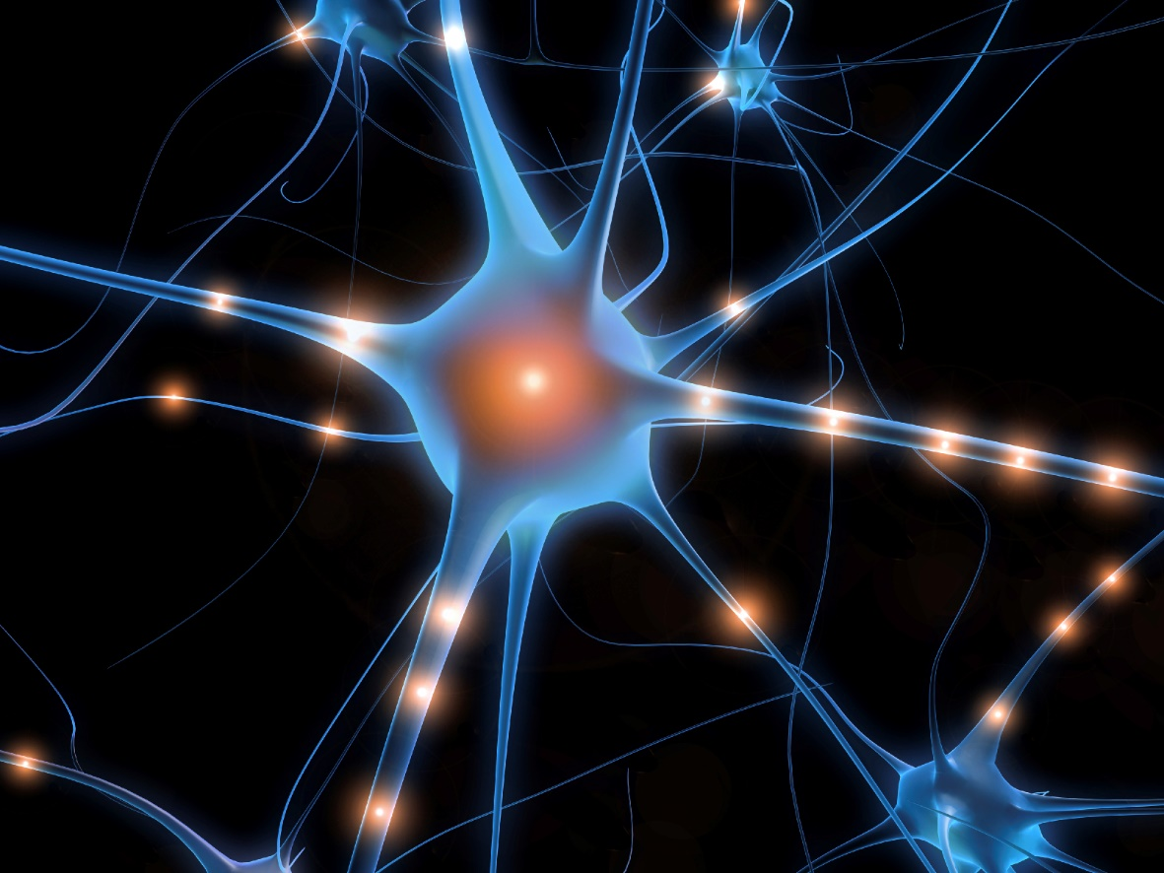
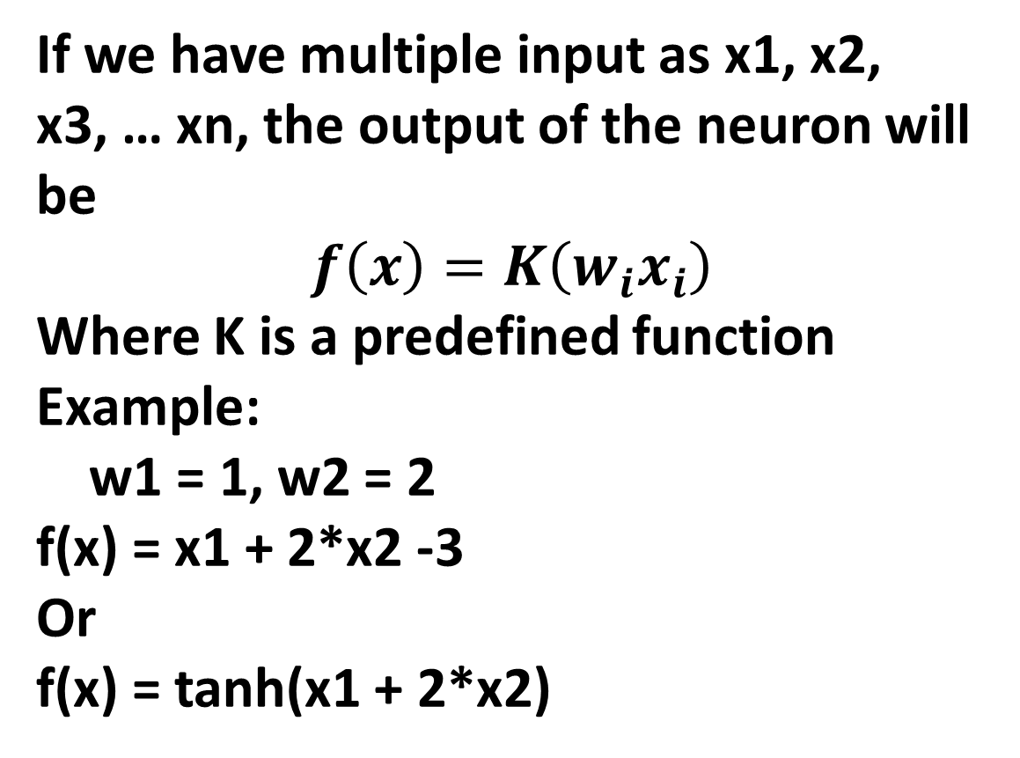
Artificial Neural Network
In Artificial Neural Network…
What is Biological Neural Network?
Input signal
If we have multiple input as x1, x2, x3, … xn, the output of the neuron will be
$$f\left(x\right)=K\left(w_{i}x_{i}\right)$$
Where K is a predefined function
Example:
w1 = 1, w2 = 2
f(x) = x1 + 2*x2 -3
Or
f(x) = tanh(x1 + 2*x2)
neuron
output
If the sum of the input signals into one neuron surpasses a certain threshold, the neuron transmits this electrical signal to next neuron.

Slide 3
Basic Neural Network Structure
Hidden layers contains multiple layers, each contains many neurons.
Each neuron has a set of different weight.
For example:
If the input is a 75 dimension vector, then in the first layer, each neuron has 75 weights(w1, w2, … w75)
The weights can be acquired using back-propagation and gradient descent.
Input could be pictures, sounds etc.
For example:
If we are processing a 5*5 pixel image, so the input will be a
5*5*3(BGR)
This input is known(we give it).
Output layers are our results.
Take a digit classification Neural Network as example:
We have 10 outcomes(0,1,2,3,4, … 9)
Output layer has 10 neuron, each neuron has an ouput between 0 and 1.
We take the neuron digit with the highest value to be our classification result.
input
output
Hidden layer

Slide 4
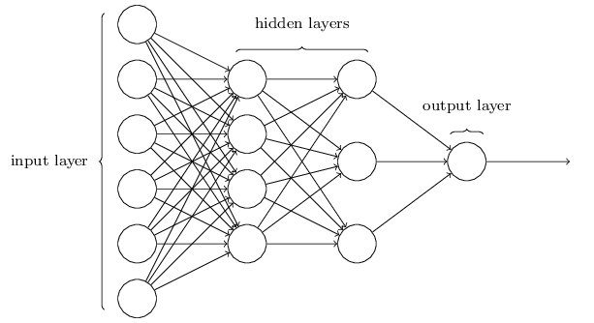
Fully Connected Neural Network

Slide 5
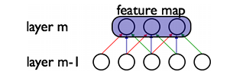
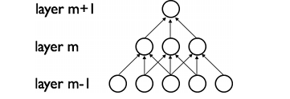
Convolutional Neural Network
Sparse Connectivity
Shared Parameters
Attributes of CNN
Sparse Connectivity
Parameter sharing
Pooling / subsampling hidden Units
Reduces numbers of parameters needs to be stored
Detect Features regardless of their position in the image

Slide 6
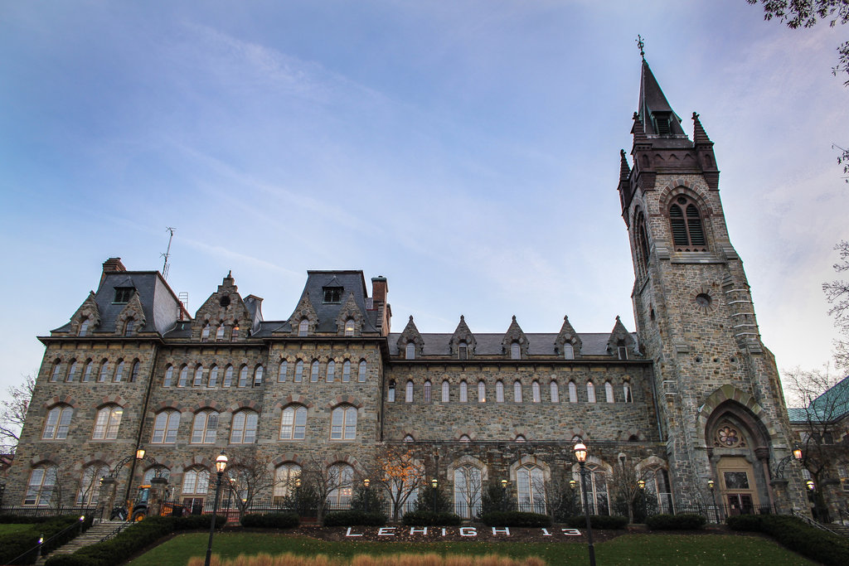
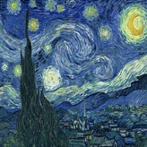
Neural Algorithm of Artistic Style
Content Image
Result
Style Image

Slide 7
Neural Algorithm of Artistic Style
Idea of content reconstruction
When Convolutional Neural Networks are trained on object recognition, they have the ability to capture the content of the picture along the hierarchy.
We can use this property and reconstruct the image using only the information in the feature maps.

Slide 8
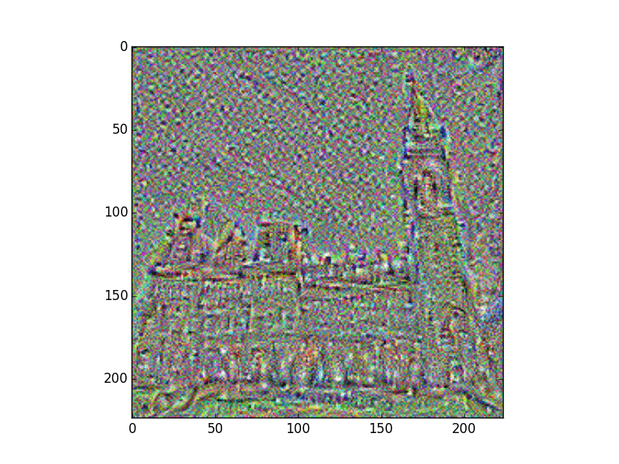
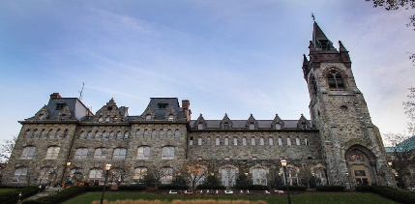
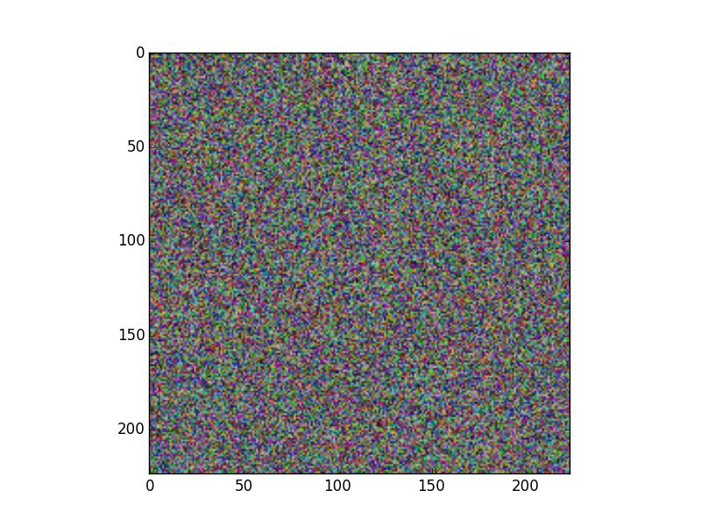
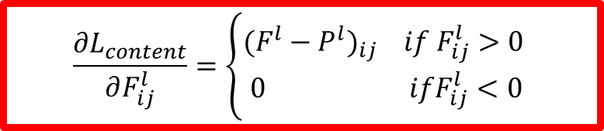
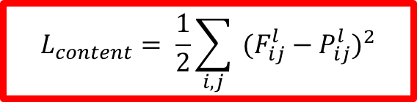


Neural Algorithm of Artistic Style
Input
Input
64 feature maps
Conv1
$$L_{content}= \frac{1}{2}\sum_{i,j}{ {(F_{ij}^{l}−P_{ij}^{l})}^{2}}$$
Conv1
128 feature maps
Conv2
Conv2
$$\frac{{∂L}_{content}}{∂F_{ij}^{l}}=\left\{\begin{aligned}{(F^{l}−P^{l})}_{ij} if F_{ij}^{l}>0 \\ 0 ifF_{ij}^{l}<0\end{aligned}\right.$$
256 feature maps
Conv3
Conv3
512 feature maps
Conv4
Conv4
512 feature maps
Conv5
$$P^{5}$$
$$F^{5}$$
Conv5
Matrix of 512*156
Matrix of 512*156

Slide 9
Neural Algorithm of Artistic Style
Idea of Style Reconstruction
Researchers in University of Tubingen found out that feature spaces of this network could be used to generate natural texture.
Given an image, we can use that to generate a image that has the same texture.

Slide 10


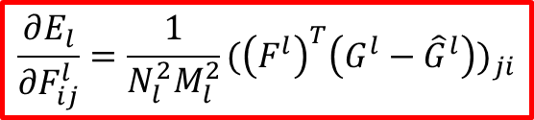


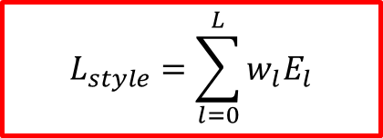
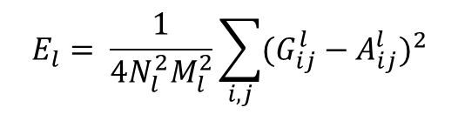







Neural Algorithm of Artistic Style
$$E_{l}= \frac{1}{4N_{l}^{2}M_{l}^{2}}\sum_{i,j}{{(G_{ij}^{l}−A_{ij}^{l})}^{2}}$$
$$G_{ij}^{l}= \sum_{k}{F_{ik}^{l}F_{jk}^{l}}$$
Input
$$L_{style}=\sum_{l=0}^{L}{w_{l}E_{l}}$$
Input
64 feature maps
Conv1
$$G^{1}$$
$${\hat{G}}^{1}$$
Conv1
128 feature maps
Conv2
$$G^{2}$$
$${\hat{G}}^{2}$$
Conv2
$$\frac{∂E_{l}}{{∂F}_{ij}^{l}}=\frac{1}{N_{l}^{2}M_{l}^{2}}{({\left(F^{l}\right)}^{T}\left(G^{l}−{\hat{G}}^{l}\right))}_{ji}$$
256 feature maps
Conv3
$$G^{3}$$
$${\hat{G}}^{3}$$
Conv3
512 feature maps
Conv4
$$G^{4}$$
$${\hat{G}}^{4}$$
Conv4
512 feature maps
Conv5
$$G^{5}$$
$${\hat{G}}^{5}$$
Conv5
Matrix of 512*156
Matrix of 512*156

Slide 11
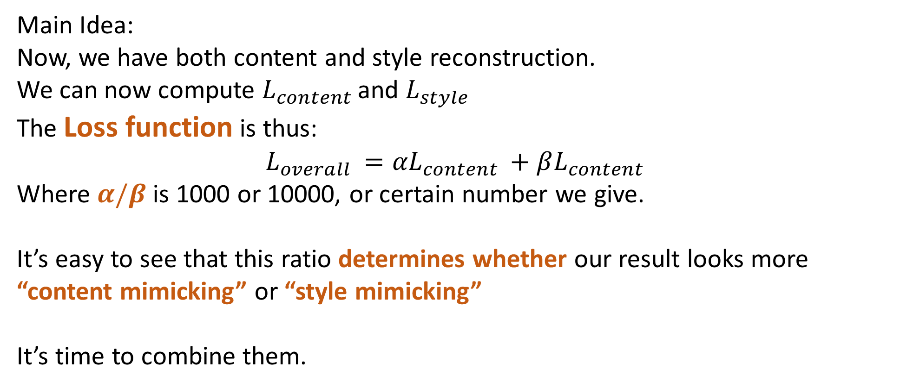
Neural Algorithm of Artistic Style
Main Idea:
Now, we have both content and style reconstruction.
We can now compute $L_{content }$and $L_{style}$
The Loss function is thus:
$$L_{overall }={αL}_{content }+βL_{content }$$
Where $α/β$ is 1000 or 10000, or certain number we give.
It’s easy to see that this ratio determines whether our result looks more “content mimicking” or “style mimicking”
It’s time to combine them.

Slide 12
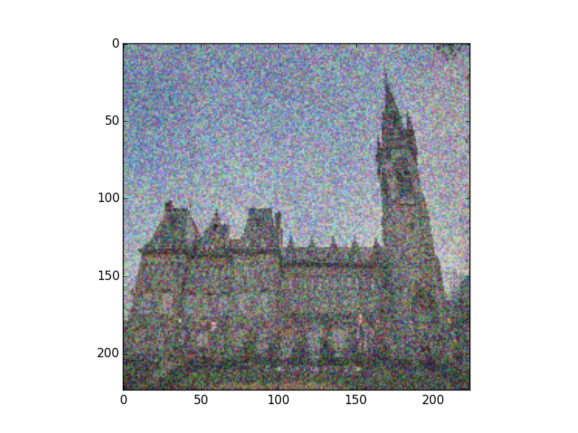


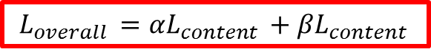
Neural Algorithm of Artistic Style
$$L_{overall }={αL}_{content }+βL_{content }$$
Input
Input
64 feature maps
Conv1
$$G^{1}$$
$${\hat{G}}^{1}$$
Conv1
128 feature maps
Conv2
$$G^{2}$$
$${\hat{G}}^{2}$$
Conv2
256 feature maps
Conv3
$$G^{3}$$
$${\hat{G}}^{3}$$
Conv3
512 feature maps
Conv4
$$G^{4}$$
$${\hat{G}}^{4}$$
Conv4
512 feature maps
$$P^{5}$$
$$F^{5}$$
Conv5
$$G^{5}$$
$${\hat{G}}^{5}$$
Conv5
Matrix of 512*156
Matrix of 512*156

Slide 13
Neural Algorithm of Artistic Style
Things I find interesting:
Different Ratio
Different Artistic Style Paintings
Structure of the Painting
Different Starting point of optimization
White Noise
Content Image
50% WN + 50% Content Image
Etc.

Slide 14
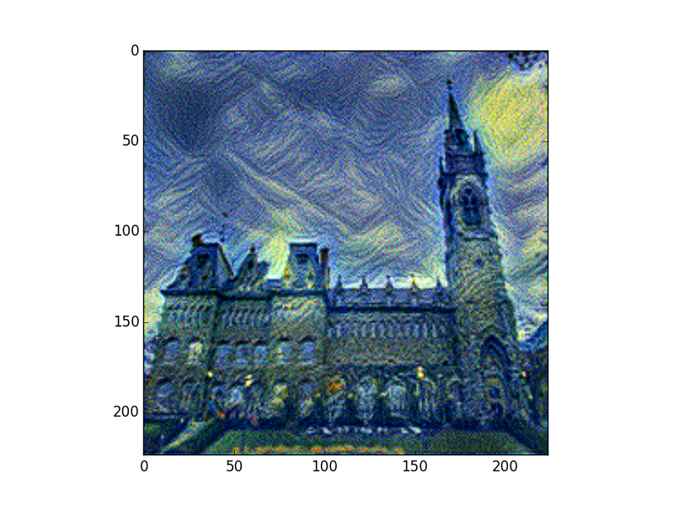
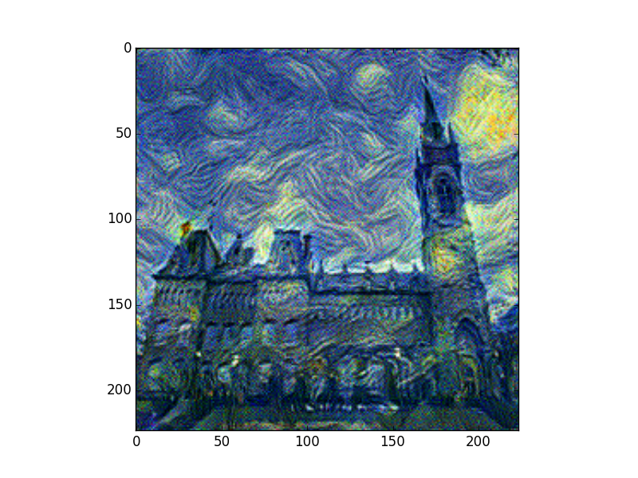
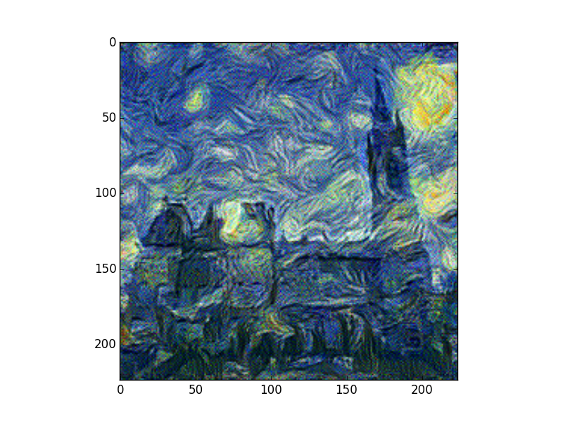
Effects of different ratio
Ratio = 10e4
Ratio = 10e6
Ratio = 10e7
Above results are obtained using conv1 & conv2 for style optimization

Slide 15
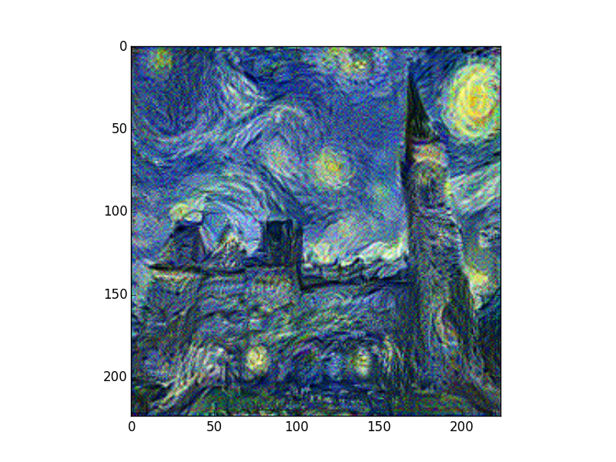
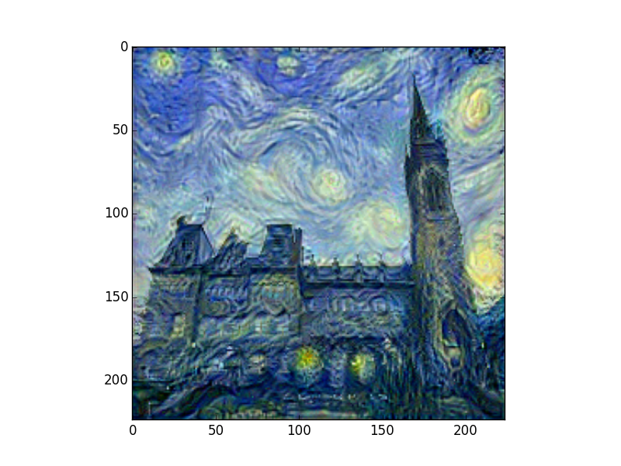
Effects of different starting point
Start as WN
Start as 50%WN and 50% Content image
Start as Content image
Above results are obtained using all 5 conv layer for style optimization

Slide 16
Effects of layers used for style reconstruction

Slide 17
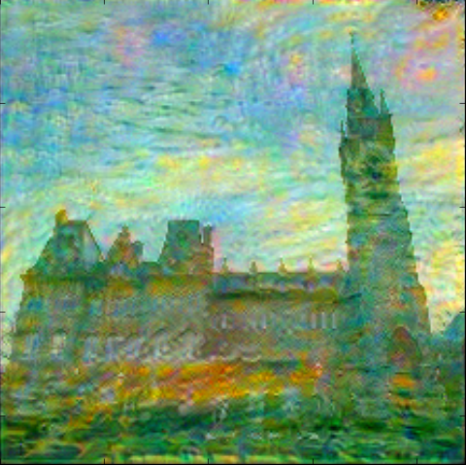
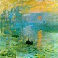
Bad examples
Reason: Artistic Style being too subtle
Result
Content
Style
Above result using conv1 & conv2 & conv3 & conv4 for style optimization and conv3 for content optimization

Slide 18
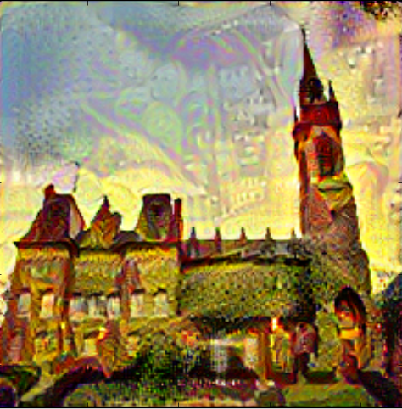
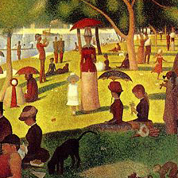
Bad examples
Reason: Structure doesn’t match
Result
Content
Style
Above result using conv1 & conv2 & conv3 & conv4 for style optimization and conv3 for content optimization

Slide 19
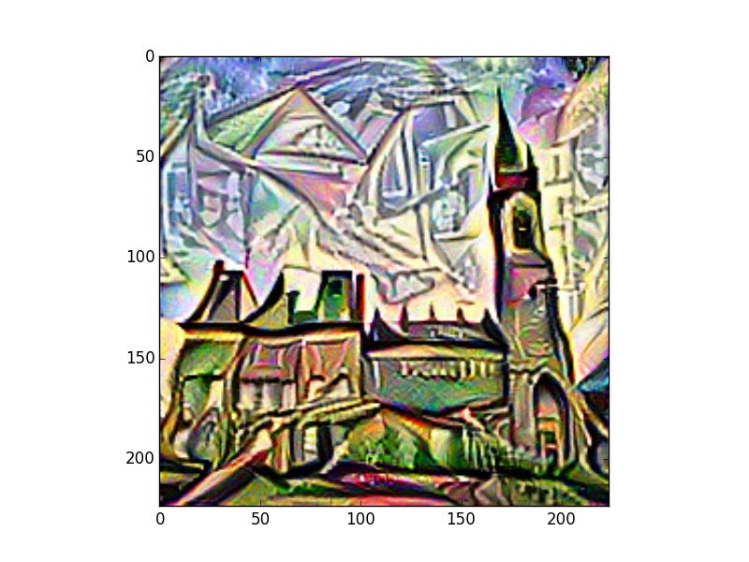
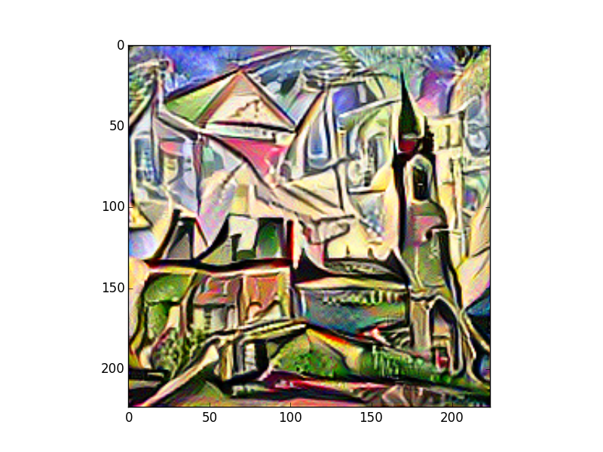
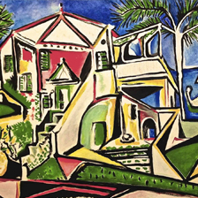
Bad examples
Reason: Structure doesn’t match / style being too much
Result
Content
Style
Above result using conv1 & conv2 & conv3 & conv4 & conv5 for style optimization and conv3 for content optimization

Slide 20
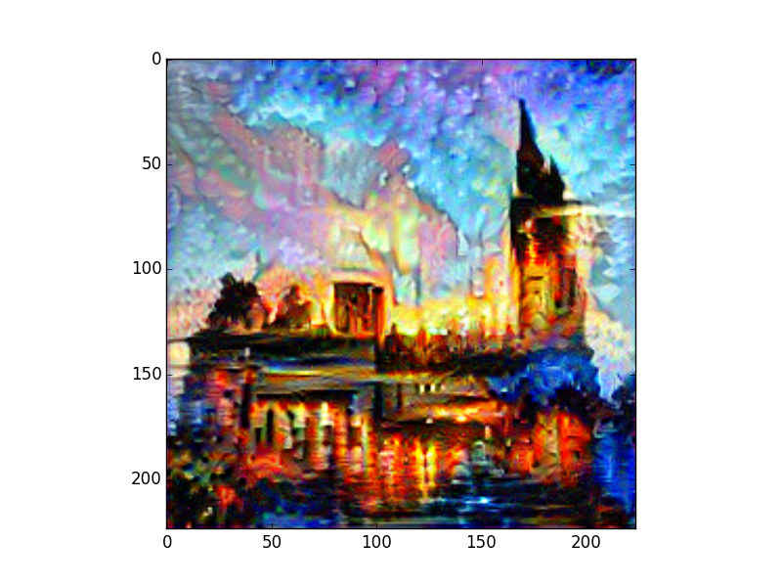
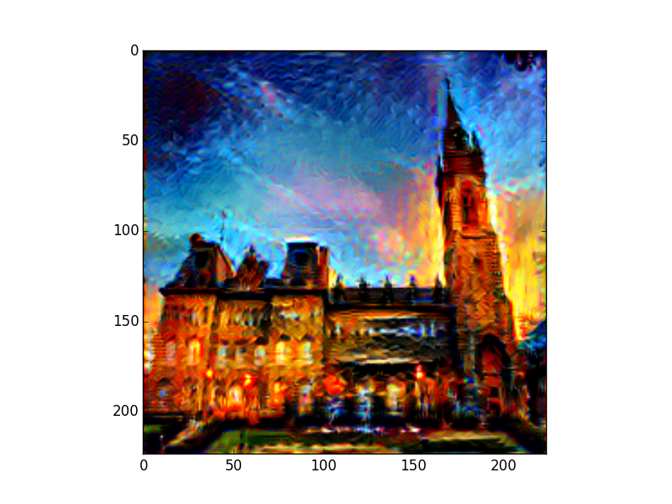
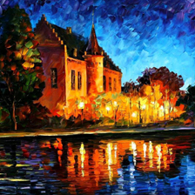
Other Results
Result
Content
Style
Above result using conv1 & conv2 & conv3 & conv4 for style optimization and conv3 for content optimization

Slide 21
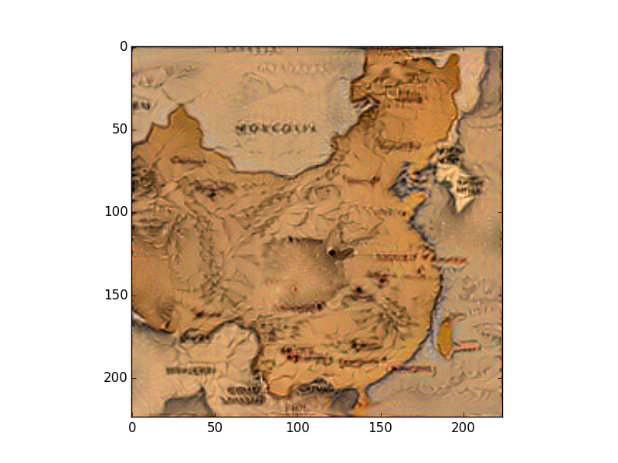
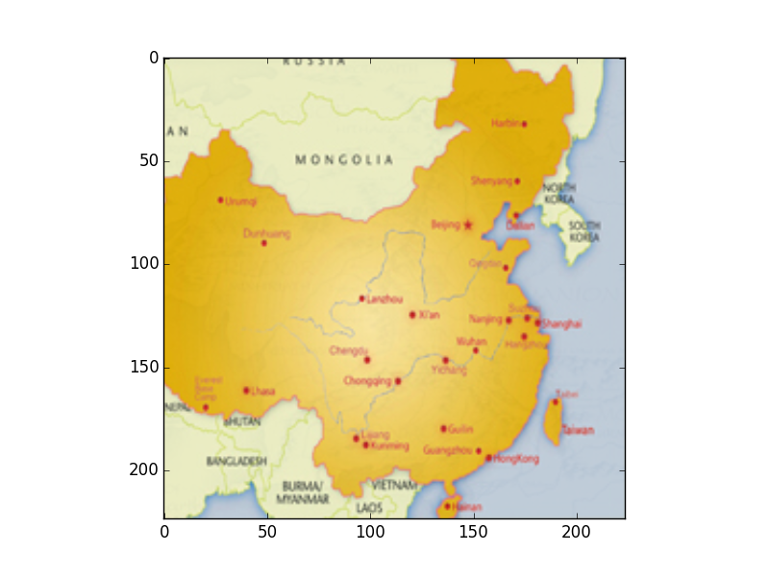
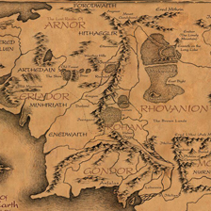
Other Results
Texture mimicking could be used on various applications
Result
Content
Style
Above result using conv1 & conv2 & conv3 & conv4 & conv5 for style optimization and conv3 for content optimization

